Slide 1


mthree Alumni Training
Introduction to Finance
Types of Banks
Investment Banking Details

Slide 2
Introduction to Finance
Objectives
The objective of this course is to give you a good foundation in the finance industry and the various business lines that operate within a bank.
You should also understand various financial products that banks offer and that you may end up working with.
Notes:
Trainer/Trainee Notes
This deck will be your introduction to the finance world, later in the course we will go into more detail of various other business areas.

Slide 3
Different types of banks
There are four main types of banks we will be covering in this course:
Central Banks
Manage the money supply in a single country or series of nations. Set monetary policy goals. US: Federal Reserve; Europe: European Central Bank
Retail Banks
Offer general public financial products and services such as bank accounts and loans.
Universal Banks
Provide a wide variety of comprehensive financial services; tailored to retail, commercial and investment services. E.g., Deutsche Bank, Bank of America, HSBC
Investment Banks
A financial intermediary that performs a variety of services. Specializing in large and complex financial transactions as well as acting as a broker or financial advisor for institutional clients. E.g., Goldman Sachs, Morgan Stanley
Notes:
Trainer/Trainee Notes
The central bank of the United States is the Federal Reserve System, or “the Fed,” which Congress established with the 1913 Federal Reserve Act. Read more: Central Bank https://www.investopedia.com/terms/c/centralbank.asp#ixzz5GSAqJr67

Slide 4
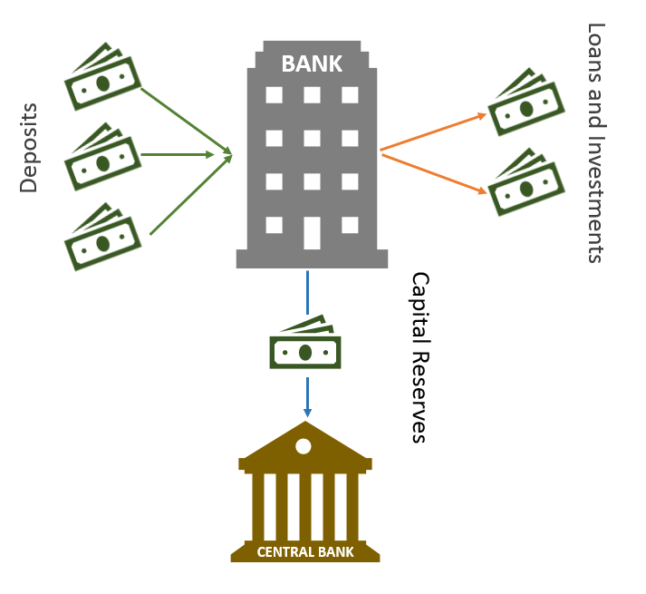
A Bank: The Basics
As hard currency came into existence, so the bank was born, traditionally taking surplus cash from lenders and acting as a financial intermediator to borrowers.
Fractional Reserve: banks assume that depositors will only want access to a fraction of their deposits at a time – the rest they will invest in money markets
Deposit: a sum of money left with a bank
e.g., 3% paid by bank to depositor
Loan: a sum of money lent from a bank
e.g., 6% charged by the bank for a loan: the bank retains the 3% and usually invests in money markets
Notes:
Trainer Notes
Brainstorm with the class: Do you see an issue with fractional reserve?
What happens when all customers try and pull their money from a bank?
A bank’s reserves may not be able to cover all the requests for money – this is a run on the bank and has happened in the past.

Slide 5
Interest Rates
e.g. You borrow $1000 at 6% for a year. After a year you must pay back $1060.
Interest
Can be defined as a fee for the use of money
Interest Rate
A percentage of the loan or deposit that is charged as interest
APR
Annual percentage rate of interest
Notes:
Trainer/Trainee notes
Depositors receive interest for money saved with banks.
Banks can use this money to lend to borrowers.
Borrowers pay interest for money lent from a bank.
Banks can use that loan interest to pay interest to depositors.

Slide 6
Evolution of Banking
Modern Banking
Money Market Funding
Securitization
OTD – Originate to Distribute
Less reliance on depositors
Borrowing on money market
Inter-bank borrowing
New derivative products
Proprietary trading
Move away from issuing products to retain them
Bank avoids bearing risk of all new product issuance
Notes:
Trainer/Trainee Notes
There are some key aspects of modern banking that are a complete departure from the traditional banking model (shown above).
Securitization
Derivative products made from bank’s own assets or others’ assets, purchased for securitization, like loans and mortgages. A contract for the cashflows from the underlying loans and mortgage repayments – We go into this in more detail in another module
OTD - Previously Originate to Hold – Banks would underwrite the products they issued, like loans, bearing the risk of default OTD – no limit to the scale of distribution if you don’t have to underwrite the risk. The distribution of risk to other parties had a part to play in 2008 financial crisis.

Slide 7
2008 Financial Crisis
Factors that led to the crisis:
Focus on short term profits
Proprietary interest over clients
New regulatory bodies
Ring fencing
Return for risk taking
Inadequate risk assessment
Effect risk assessments
Transparent markets
Junk debt traded in securities
Inadequate capital reserves
Stress resilient capital reserves
Ethics and culture
Notes:
Trainer notes
Brainstorm with the class: Who knows what happened in the crisis?
Trainee notes
We go into more details around the 2008 crisis in another module – the important point to note here is that the regulatory scrutiny is much greater in the last few years and will be a big part of your day to day work

Slide 8
Retail Banking
Banking for individual consumers, they cover the following product types. Also known as chartered banks in Canada.
Current Accounts
Mortgages
Debit Cards
Savings Accounts
Personal Loans
Checks
Overdrafts
Payments
Money Transfers
Telephone Banking
Branches
Online Banking
Notes:
Trainer/Trainee Notes
Most if not all people in the class will use a retail bank for their everyday banking needs.

Slide 9

Banks – Monetary Policy
Retail banks can set their own rates for lending and borrowing money to their clients. The rate to lend between banks is usually set by the central bank.
LIBOR: Benchmark interest rate at which major global banks lend to one another in the international interbank market for short-term loans. (Rate is calculated and published each day by the Intercontinental Exchange – ICE).
Barclays borrows at 1.33% (set by Barclays)
Barclays lends at 0.93% to HSBC (Set by Barclays)
Barclays borrows at 0.91% from HSBC (Set by HSBC)
Barclays lends at 5.5% (set by Barclays)
LIBOR is an average – in this case 0.92%
Notes:
Trainer/Trainee Notes
LIBOR – London inter-bank offered rate
We go into more detail of uses of LIBOR in a later module.

Slide 10
Central Banks – Interest and Inflation
Interest Rates: The percentage of principal charged by the lender for the use of its money.
Inflation: Quantative measure of the rate at which the average price level of selected goods and services in an economy increases over time. It indicates a decrease in the purchasing power of a nation’s currency.
The central banks will make changes to interest rates to have an impact on inflation. (They usually have a target of what inflation should be over a given time period.)
Encourages Spending
Increases Inflation
Encourages Saving
Decreases Inflation
Lower Interest Rates
Raise Interest Rates
Notes:
Trainer/Trainee Notes
When you have banks using fractional reserve banking central banks such as the FED can change interest rates to impact the rate of inflation. When interest rates are low the economy tends to grow. This is because more people are able to borrow more money – therefore they have more money to spend causing the economy to grow and inflation to increase.
In the US, the Federal open market committee (FOMC) meet 8 times a year to review the current financial conditions and assess whether they should change interest rates. This is done to meet target employment rates, stable prices and economic growth. This will always cause a flurry of trading activity after one of these announcements.
Central Banks = Banks for the Banks and State/Government
Bank of England
Federal Reserve System
Bank of Canada
European Central Bank
Hong Kong Monetary Authority
Functions
Holds Bank fractional reserves
Banking services for the State and other Central Banks
Bank Supervision
Lender of Last Resort
Money supply
Monetary policy/Setting Interest Rates

Slide 11
Quantitative Easing (QE)
The Central Bank creates new money electronically - Quantitative Easing (QE)
This money is used to purchase government bonds or other assets, increasing the money supply ultimately encouraging lending and investment
Increases bond prices, reduces yield and encourages/frees up money to be invested elsewhere
Increased lending supply, lowers the cost of borrowing
Used when interest rates and inflation are very low and need boosting via spending
“Central Banks as a Safety Net”
Notes:
Trainer/Trainee notes
Quantitative easing was first used in the UK in 2009. It is considered a form of extraordinary monetary policy used by central banks to spur economic activity
The federal reserve announced a $700+ billion QE program on March 15, 2020 to help the US economy amid COVID-19.
News articles in the past suggested that Canada may try quantitative easing since oil prices were falling so significantly and interest rates are already very low
https://www.bloomberg.com/news/articles/2016-01-19/meet-four-guys-betting-canada-is-due-for-quantitative-easing
There can be drawbacks to quantitative easing – if money supply is increased, it can increase inflation. It can also devalue the domestic currency, which will in turn have impact for importing goods.

Slide 12
Corporate Banking
Banking for different size businesses offering retail banking services plus:
Multi-Bank Syndicated Loans
Larger loans supported by a group of banks to spread the risk of the loan and raise the capital required, usually available at short notice, cheaper than a bond issue
Foreign Exchange Facilities
Providing competitive foreign exchange facilities including help with balance sheet analysis and hedging solutions and managing exposure and risk to FX movements
Cash Management Services
Movement of money between various accounts as needed
Letters of Credit
and Guarantees
Assurance from the bank that an exporter will be paid after shipping goods
Lines of Credit
Business form of an overdraft but not set up as a negative balance on your account; the line of credit is set up on another account
Notes:
Trainer/Trainee Notes
When looking at cash management services, think about big global companies such as Amazon or Apple. If they need to pay their various developers or marketplace sellers who are located all across the world, they will need a good money system to do that. The global reach of a corporate bank is very important for them to retain clients such as Amazon and Apple.

Slide 13
Private Banking and Wealth Management
Banking for high net worth individuals with more than $1 million of liquid assets.
Examples of such individuals:
Entrepreneurs
Executives
Landowners
Celebrities
Royalty
In addition to retail services they also offer:
Advice and Management
Personal Relationship
Wealth Structuring
Tax Planning
Investment Planning
Discretion
Notes:
Trainer Notes
Brainstorm: What is a liquid asset?
Trainee Notes
A liquid asset is something you can convert into cash within a short amount of time – e.g., cash or shares, etc. Selling property for example is not a liquid asset as it will take some time to release the cash.

Slide 14
Investment Banking
Who are clients of an investment bank?
Professional
Clients
Assumed to be more informed investors and as such, can take more financial risks than other types of investor
Have experience, knowledge, and expertise to make their own investment decisions & risk assessment
Covered by less regulatory guarantees
Institutional Investors
Investment firms, pension funds, insurance firms, commodity dealers, hedge funds, asset managers, national and regional governments, sovereigns
International and supranational institutions: World Bank, IMF, Central Banks
Notes:
Trainer/Trainee Notes
Institutional investors are investing money on behalf of their members.

Slide 15
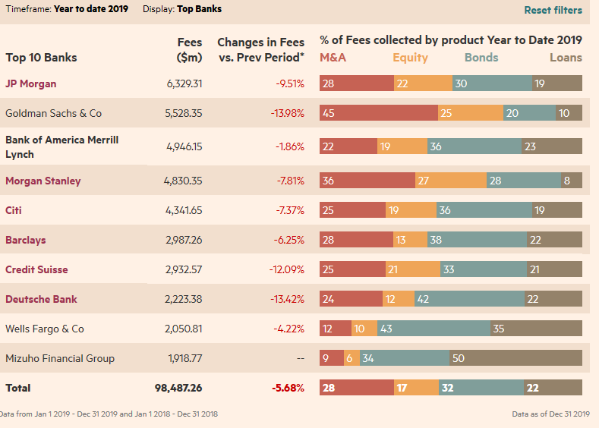
Investment Banking
Services include:
Company Restructuring
Mergers and Acquisitions
Financing
Security Issuance Underwriting
Research and Advisory
Brokerage and Market Making
Notes:
Trainer/Trainee notes
After the Great Depression in America in the 1930s, banks had to either be commercial (corporate banks) or investment banks.
If they were investment banks, they couldn’t take deposits, but they could operate in market related activities.
If they were corporate banks, they could take deposits but were restricted from market activities. (Glass-Steagall Act 1933, which was repealed in 1999)
Image source: https://markets.ft.com/data/league-tables/tables-and-trends

Slide 16
IB – Research and Advisory
Research and advisory is often offered to clients free of charge to gain good will and encourage them to use other fee-based services.
Buy/Sell/Hold Recommendations
Stock ratings; portfolio balancing; overweight/underweight on securities
Financial Trends
and Forecasting
Market trends and consumer trends
Politics and
Macro Economics
Information on major events and news, supply and demand
Market Analysis
Technical analysis and market risk models
Notes:
Trainer/Trainee notes
Research is considered a great selling point of a bank – being able to offer this to clients is an added bonus and could attract a client to do business with you over another bank offering similar services.

Slide 17
IB – Financing and M+A
Financing
Mergers and Acquisitions
Used when a client needs to raise capital:
Advice
Investor Introductions
Syndicate Loans
Bond and Securities Issuance
Project Financing
Very lucrative part of the IB business.
Why would you want to merge?
Make money for shareholders (ideally)
Economies of scale, especially in areas such as research and development
Gaining larger market share
Better competition against other firms
e.g., Bank of New York and Mellon Financial Corporation combined to form BNY Mellon.
Notes:
Trainer/Trainee notes
Syndicate Loans – a group of people supporting a single loan –i.e. banks, hedge funds, pension funds (spreads risk for lenders and allows them to take part in an investment opportunity that would be too big for them on their own)
(distinct from multi-bank syndicated loans that a corporate bank would offer, due to different types of investors supporting the loan).
Investment banks also support:
Corporate Restructuring
Selling off subsidiaries
These are all corporate actions.

Slide 18
Capital Markets
Investment banks facilitate the operation of the capital markets alongside exchanges, brokers, interdealer brokers and market data providers.
Markets have generally moved on from open out-cry trading, which has been replaced by electronic trading.
We split the markets into primary and secondary:
Primary Market
“The market that raises medium- and long-term financing (capital) for the issuers of share and bond securities”
New security issuance
New bonds
New shares
IPOs
Secondary Market
Buying and selling of securities
Trading
Notes:
Trainer notes
Quiz: what is the difference between a security and a share?
Securities are financial instruments that are exchanged among the investors in the forms of debt, equity or an agreement for a specific return value for the principal is decided. Shares are identified as a type of security that aims to raise funds for the corporations from the market.
There isn’t a physical difference between the primary and secondary markets – it simply refers to whether it’s the primary issue of something or the resell on of securities between parties.

Slide 19
Secondary Market Services
Brokerage - Brokers
Market Making - Dealers
Broker Securities Dealing
Match Buyers and Sellers
Make a Market for a Security
Offer a Buy and Sell Price
Fees:
Upfront, Spread
Quarterly Charge
Long-Term
Holding
Dividends
Generate Fees from the Buy - Sell Price Spread
Hold an Inventory of Securities to Supply This Service
Notes:
Trainer/Trainee notes
We cover market making in a bit more detail in the equity module.

Slide 20
Investment Banking
Risks – Diversification
Diversification: A risk management strategy that mixes investments within a portfolio – this limits exposure to one type of asset.
All investments involve some level of risk.
Operational Risk
System, people and process failures
Financial and Reputational Damage
Market Risk
Loss due to market volatility
Credit Risk
Defaults leading to financial loss
Notes:
Trainer/Trainee notes
What do we mean by exposure here?
What is everyone’s personal risk appetites? Think about the difference between each person and perhaps a company.
Exposure here is the amount of money that an investor has invested in a particular asset. It can be expressed in cash terms or as a percentage of an investment portfolio.

Slide 21
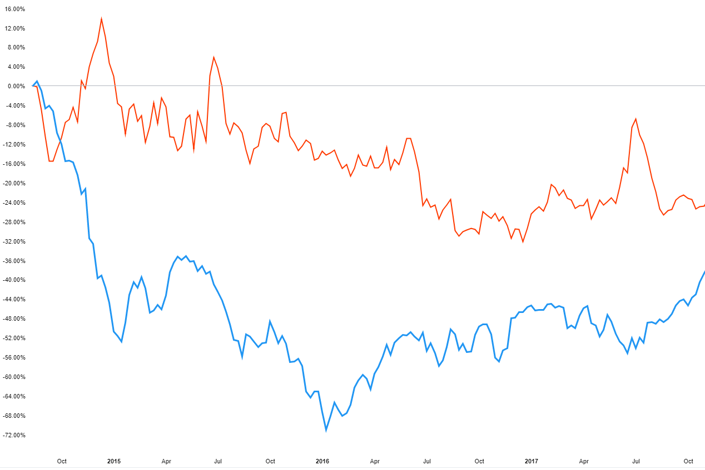
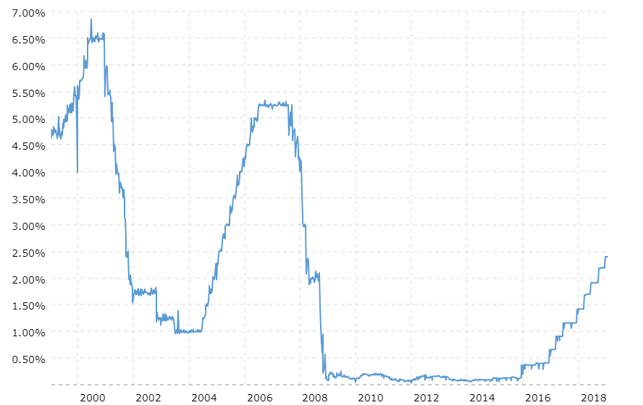
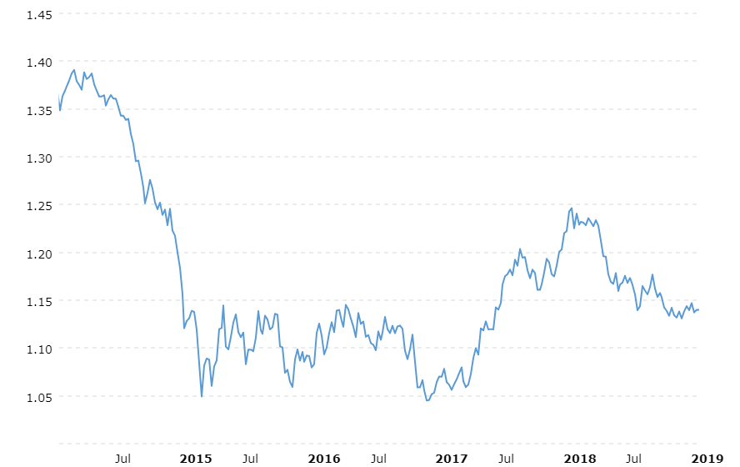
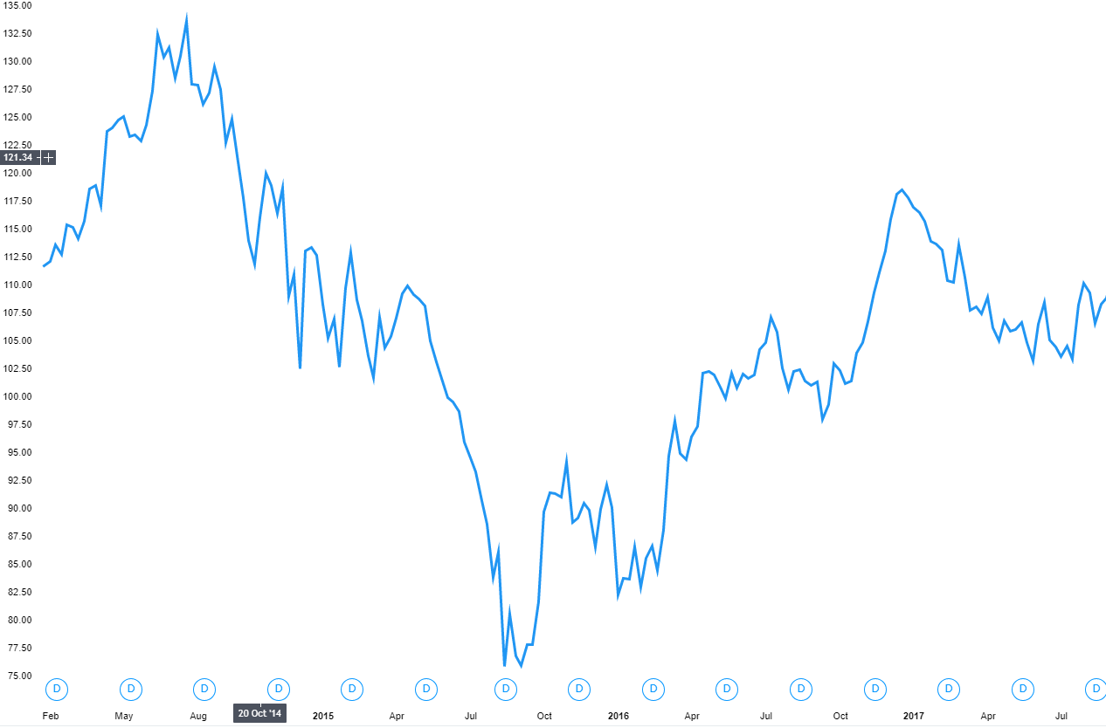
Market Risk
Commodity Prices
Interest Rates
These are four standard market risk factors:
Prices rising and falling due to market sentiment
The risk that movements in prices lead to losses
Hedging to mitigate against market risk
Wheat
FED Rate
Crude Oil
FX Rates
Stock Prices
EUR/USD
CHEVRON CORP. (US oil company)
Notes:
Trainer/Trainee Notes
Here we look at risk factors that will influence market prices – we will go into more details later in other finance modules about how this influences some financial instruments

Slide 22
Investment Banking
Investment banks are usually split up into front office, middle office and back office functions.
Front Office
Client-Facing: Interact with clients; build relationships
Revenue-Generating: Sell research, advise, brokerage
Middle Office
Support: Support front office functions
Validation: Verifying front office transactions
Back Office
Settlement: Daily trades are netted/paid and received
Custody: Register new product owners
Regulatory Reporting
Accounting: Financial reporting
Notes:
Trainer/Trainee Notes
What is netting? Offset a position in one security with another – e.g., bought 100 shares of Apple and sold 50 in two different transactions – left with 50
You will hear these terms very commonly when working in a bank.

Slide 23
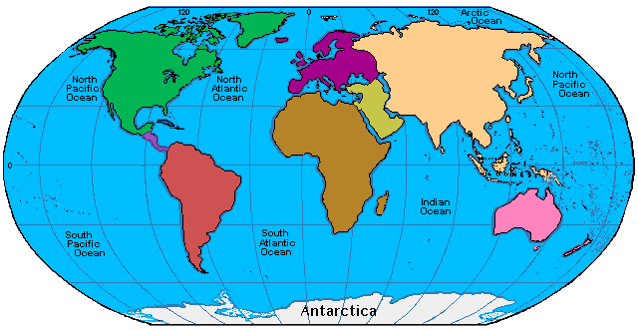

The 24 hour banking day
Depending on the business area, the bank applications could be being used through 24 hours and potentially 7 days a week (think online banking). This introduces follow the sun.
London/Euro Markets Open:
08:00 GMT
HK Market Open:
01:30 GMT/09:30 HKT
US Market Open:
14:30 GMT / 09:30 ET
Tokyo Market Open:
00:00 GMT / 09:00 JST
Follow the Sun Support Model
Notes:
Trainer /Trainee notes
It is important to understand how a bank operates globally and how you will fit into that model.
The above example refers to the equity markets. Daylight savings changes do not happen consistently across the globe and can be something that may catch you out a couple of times a year!
https://www.stockmarketclock.com/

Slide 24



Front Office Trading
Front office trading can be divided into proprietary trading, brokerage, and research areas. There are rules around what interactions these areas can have and they are generally separated by Chinese walls.
Proprietary Trading
Brokerage
Research
Buy Side
Sell Side
Prop trading occurs when a trader trades stocks, bonds, currencies, commodities, derivatives or any other financial instruments with the firm’s own money
The sell side is involved in creation, promotion and sale of stocks, bonds, FX, and other financial instruments.
Investment bankers serve as intermediaries between security issuers and investing public and the market makers who provide liquidity in the market.
Notes:
Trainer/Trainee Notes
Examples of buy-side people: e.g. hedge funds, pension funds – most banks have a prop desk although there are some restrictions as regulations have increased.

Slide 25
Types of Asset Classes
There are multiple types of asset classes that investment banks deal in.
Equities
Shareholder equity: represents the amount of money that would be returned if all assets of the company were liquidated.
Fixed Income
An investment that provides a return in the form of fixed periodic interest payments and eventual return of principle at maturity
Cash and Money Markets
Trade in short term debt: relatively low rate of return but considered low risk
Foreign Exchange (FX)
The trading of currencies
Commodities
Tradable commodities consist of basic goods used in commerce; e.g., energy. Usually executed through future contracts that standardize quantity and quality
Real Estate
Property made up of land as well as anything on it; e.g., buildings, natural resources and animals
Notes:
Trainer/Trainee Notes
We go into a lot more detail on these topics as we work through the finance modules.

